Slide 1

Some Basic Principles of Design
CRAP or PARC Or carp – Your Choose!
Modified from: www.anderson.k12.ky.us/Downloads/Principles%20of%20Design2.ppt

Slide 2
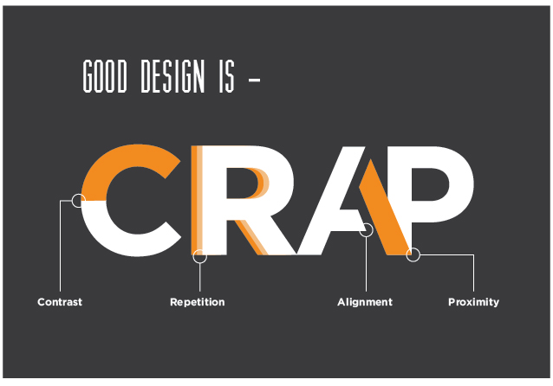
Crap Principles
Contrast
Repetition
Alignment
Proximity
https://markpearlblog.wordpress.com/2016/09/15/week-2-crap-design-principles/

Slide 3
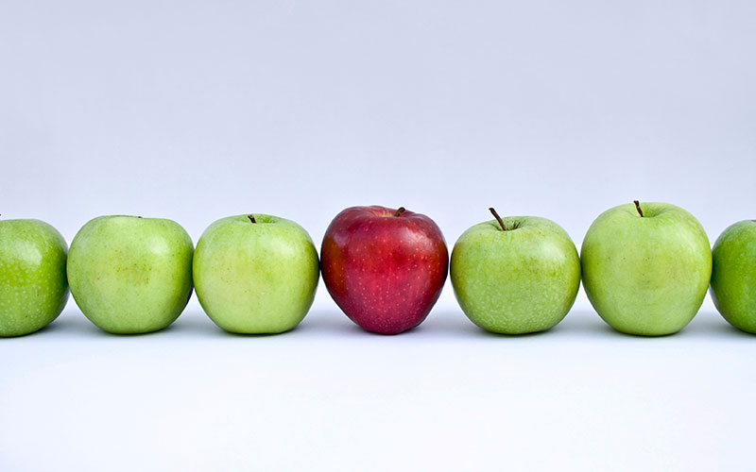
Contrast
https://thinksem.com/blog/ctas-color-versus-contrast/

Slide 4
The principle of Contrast
If two items are not exactly the same, make them different. REALLY DIFFERENT!
How?
Font size (large and small)
Font face (graceful old style serif against new bold sans serif)
Thin lines and thick lines
Cool colors against warm colors, dark against light.
Shape (tall and narrow against short and wide), geometric.
Wide and narrow spacing
Smooth texture and rough texture

Slide 5
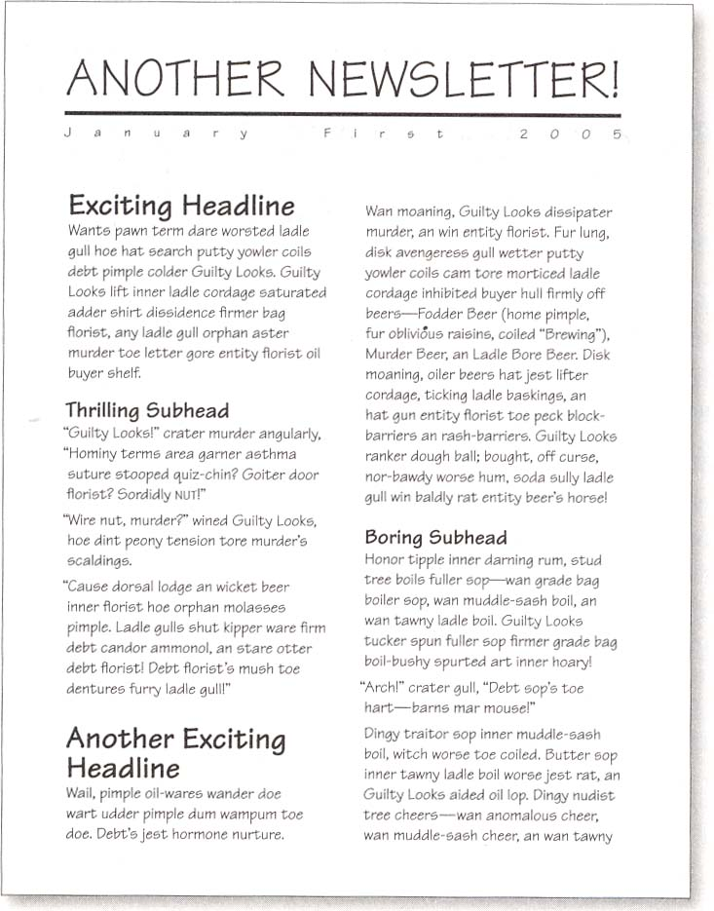
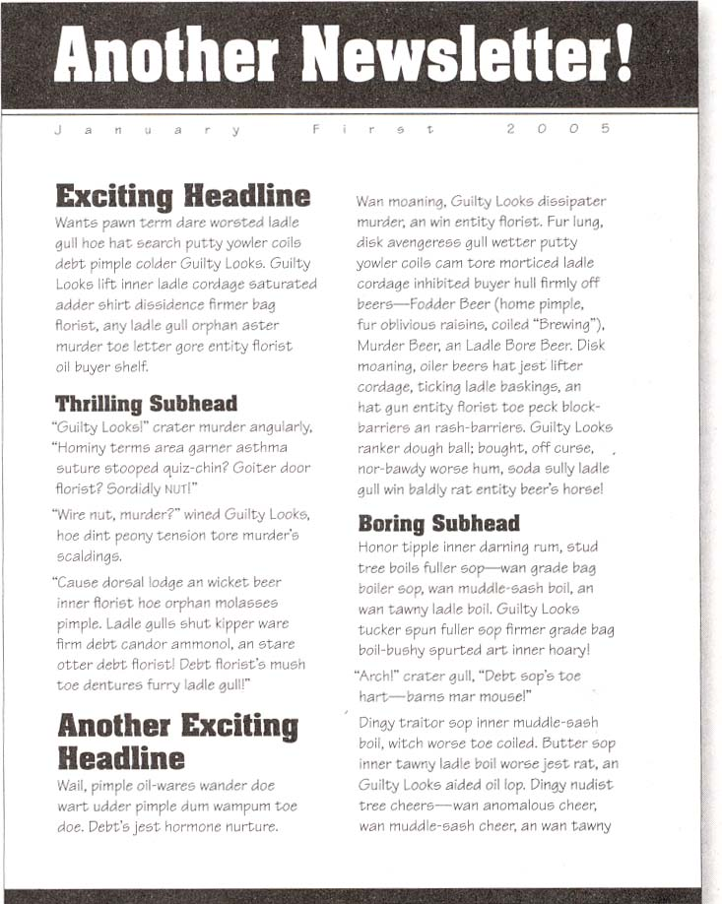
Which did you look at first?

Slide 6
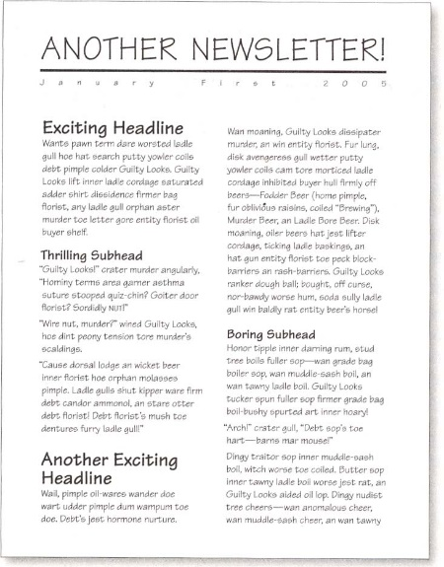
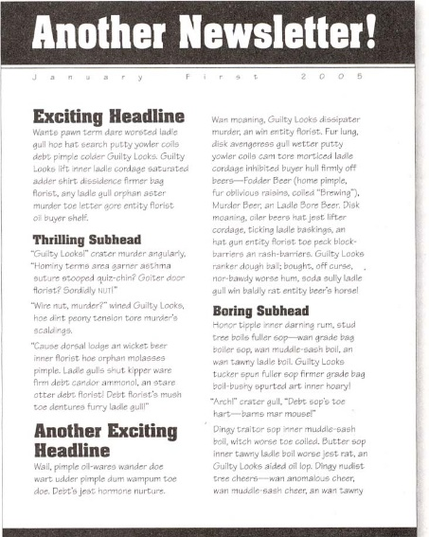
Compare/Contrast
Both news letters are neat.
Both are arranged the same.
The info is the same.
The difference is the contrast.

Slide 7
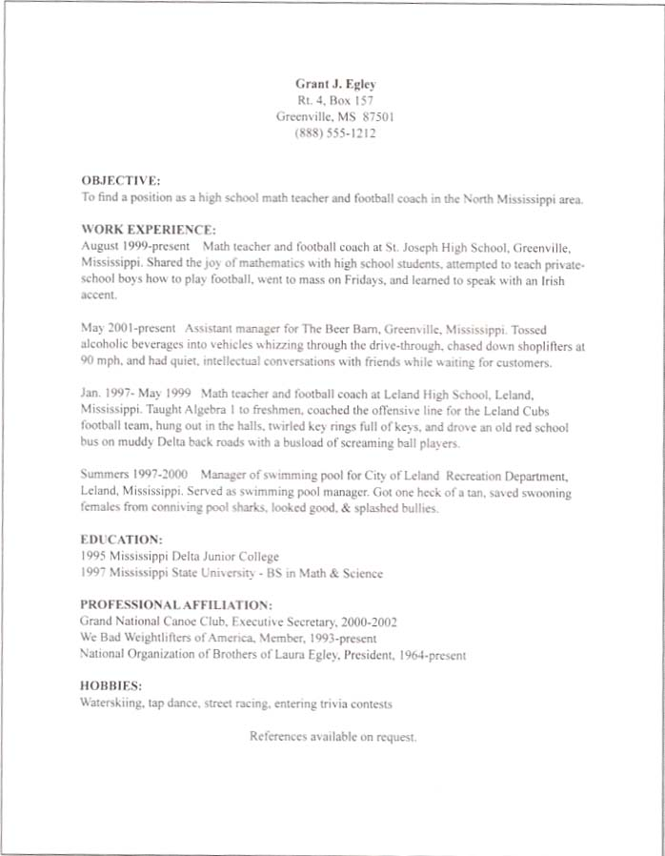
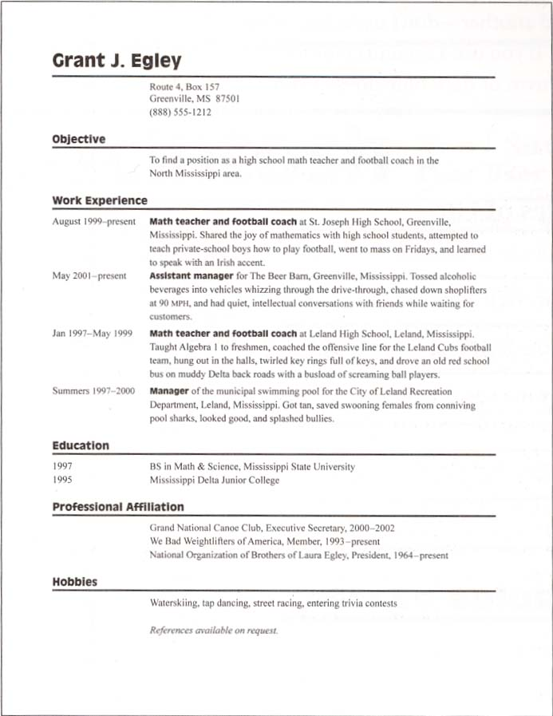

Slide 8
Make it obvious….
A reader should be able to glance at a document and understand what is going on.
Information can be organized, but blend together. This can make the content unclear at first.
Make the contrast as obvious as possible. Wimpy contrast can look like a mistake.
Elements that are made to contrast may not contrast enough.

Slide 9
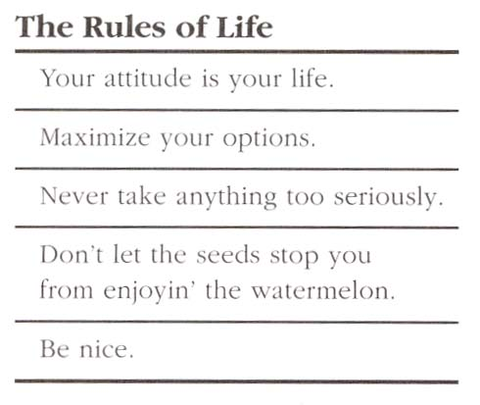
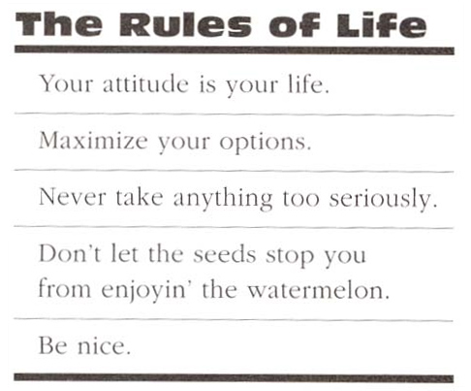
Make it obvious…

Slide 10
Shapes can be fun too!
Shapes can easily be contrasted. Circles against squares, for example.
Shapes can also be found in other places. Columns of text, for example, are rectangles. Use these to your advantage.
One way to do this would be to contrast vertical columns with horizontal rows.

Slide 11
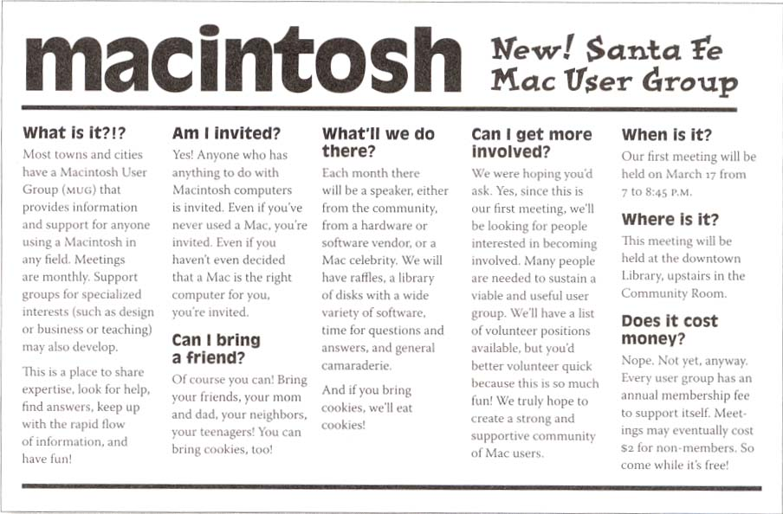
Horizontal vs Vertical

Slide 12

Oh the Drama…
Contrast can be the most fun element to work with, and is usually the most dramatic by far.
Simple changes in contrast can have a huge effect.
https://cameracourses.ca/using-contrast-in-your-photography/

Slide 13
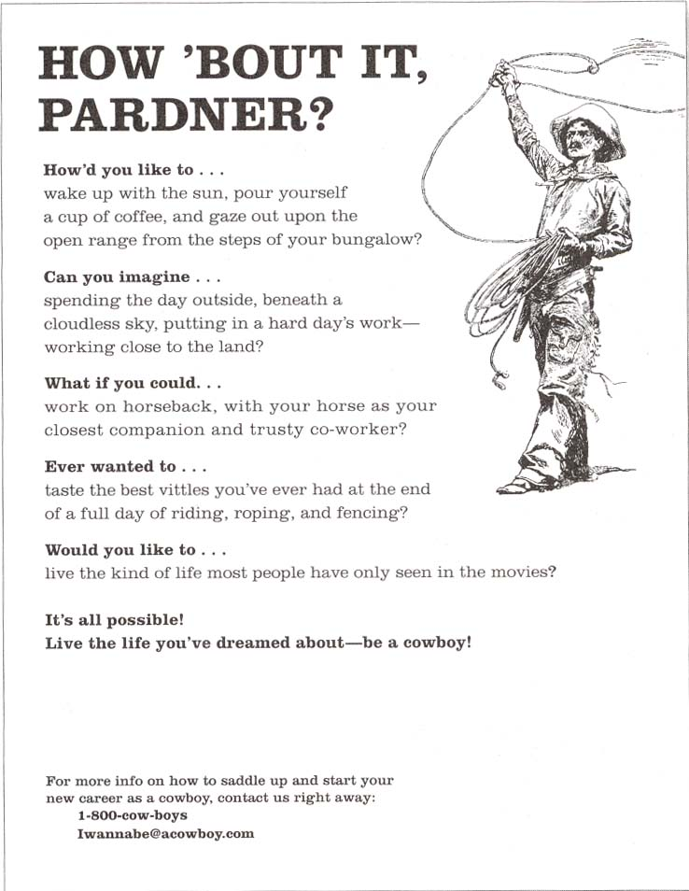
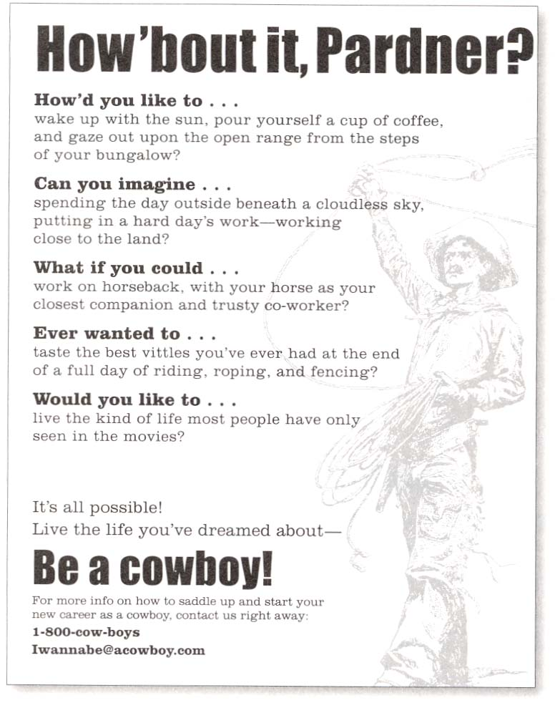

Slide 14
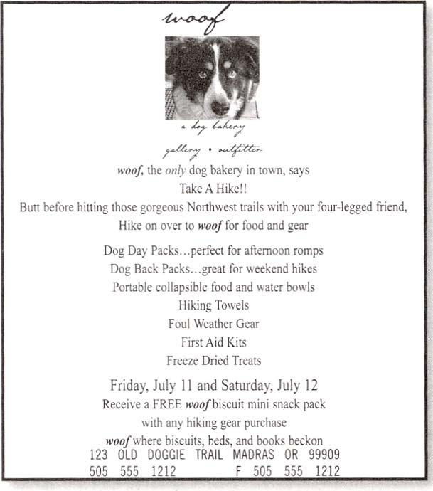

Emphasize Important Things
Find the most important things on the page and emphasize them.

Slide 15
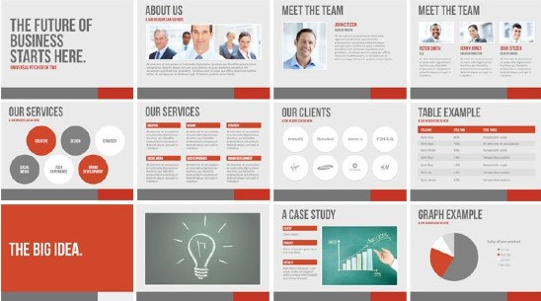
Repetition

Slide 16
The principle of Repetition states…
You repeat some aspect of the design throughout the entire piece.
That repeating element could be:
A bold font
A thick line
A color
A spatial relationship
A particular format
And so on and so forth

Slide 17

What does it add?
Adds cohesiveness to the look and feel of a multi-piece work.
It is a conscious effort to unify all parts of a design
Don’t be afraid to be bold, creative and original.
Take an existing element and push it further

Slide 18
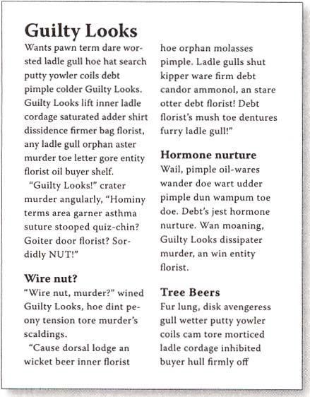
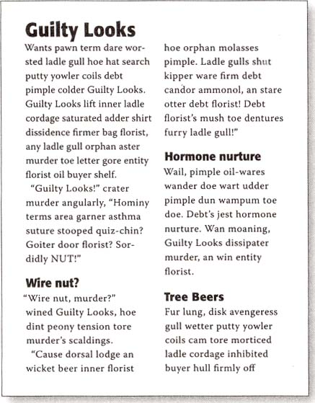
Headlines, for instance

Slide 19
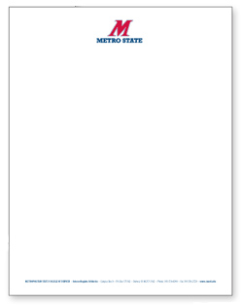
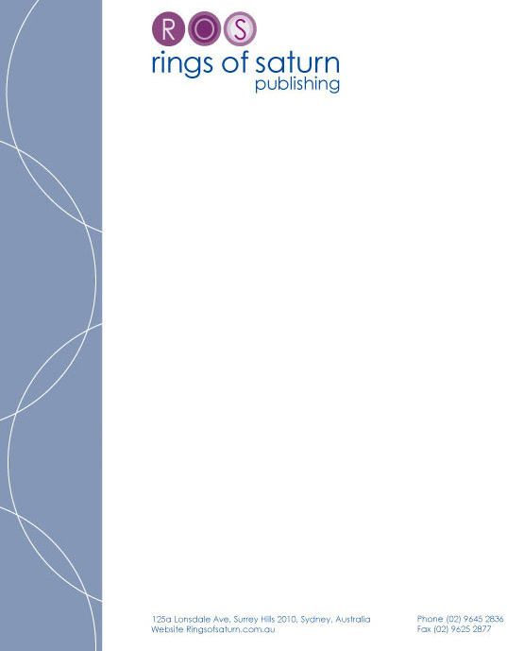
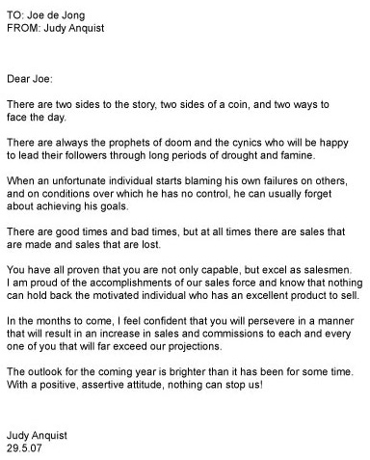
Letterhead/Business Identity

Slide 20
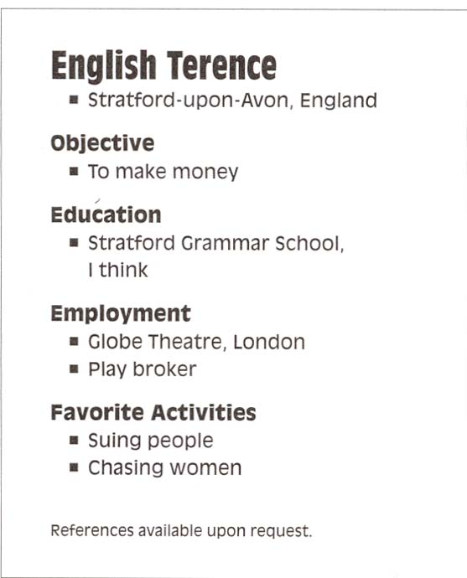
What elements are repeated?
Bold Typefaces
Light Text
Square Bullets
Spacing
Indents
Alignments

Slide 21
Less is more…
The suggestion of a repeated design can be enough.
In other words, it may not be necessary to repeat the entire element, just a part of it.

Slide 22
Repetition in a Nutshell
Basic purpose…
Unify and add visual interest
Strengthen a piece and tie it together
What to avoid…
Avoid repeating the element so much that it becomes annoying, or overpowering.

Slide 23
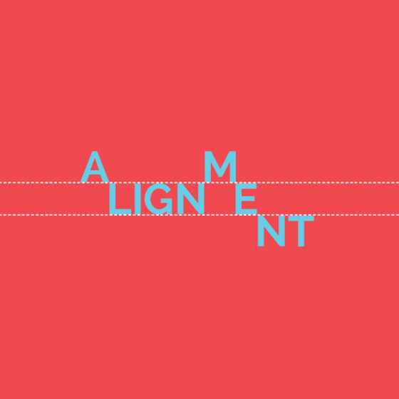
Alignment
https://www.canva.com/learn/the-art-of-alignment/

Slide 24
The principle of Alignment states…
Nothing should be placed on the page arbitrarily (randomly).
EVERY item on the page should have a visual connection with something else on the page.
Find a strong line and USE it.
When items are aligned, it creates a stronger, cohesive unit.

Slide 25
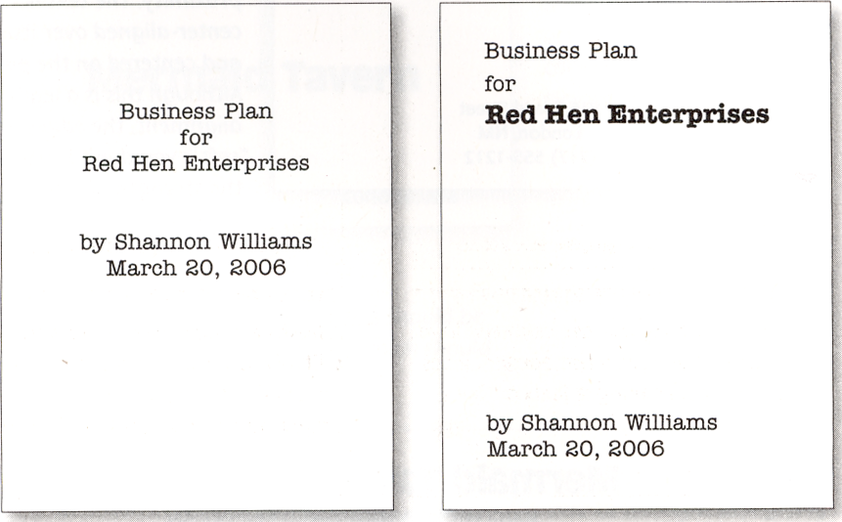
Example

Slide 26
Center Alignment
Creates a more formal look
Works well for invitations, greeting cards, etc.
Safe, easy
Sometimes it can be sedate and/or boring
Be conscious and creative with centering.

Slide 27
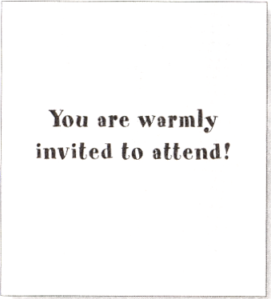
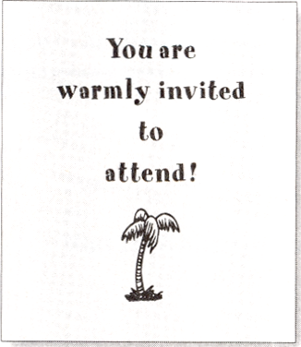
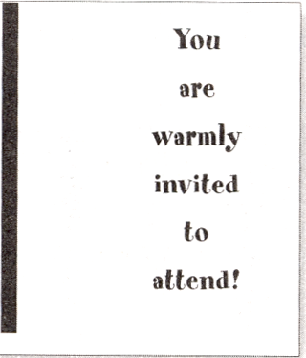
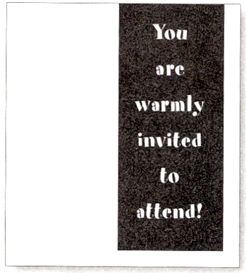

Slide 28
Mixing Alignments
This should be avoided at first.
Stick to using left only, right only or centered only for now.
Mixing can disconnect items on a page if it is done incorrectly.

Slide 29
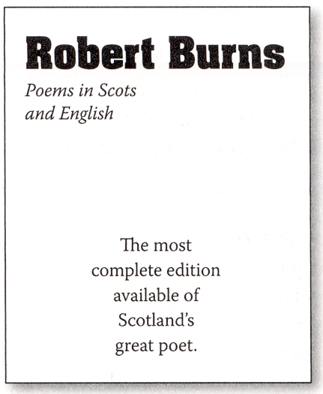
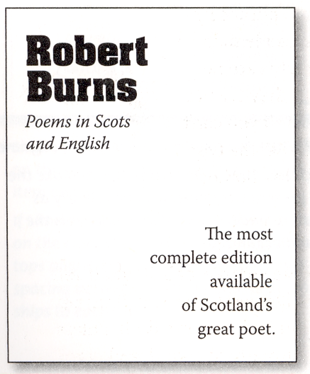
Example

Slide 30
White Space
Don’t forget to watch your white space
Outside white space can add an invisible border, strengthening alignment.
Interior white space can strengthen lines, or push items apart if used incorrectly.

Slide 31
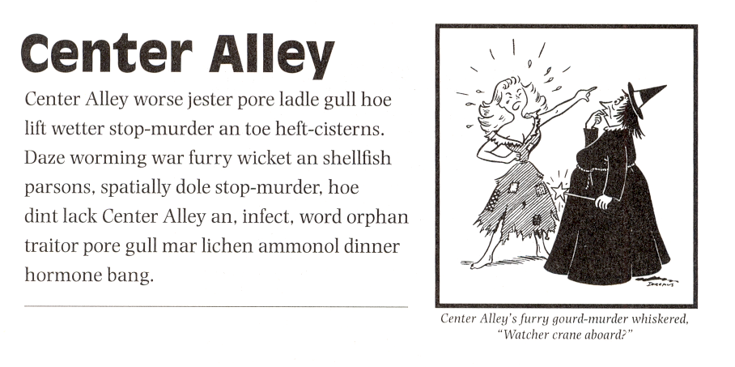
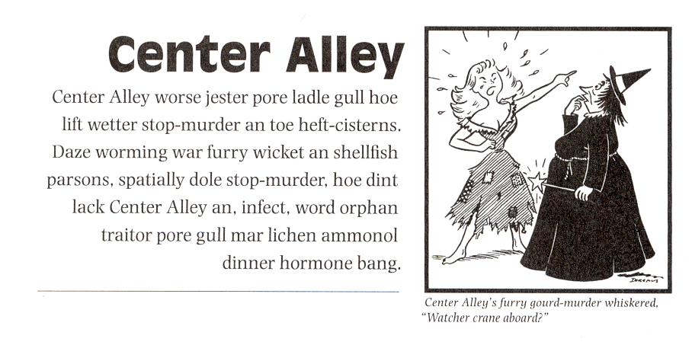

Slide 32
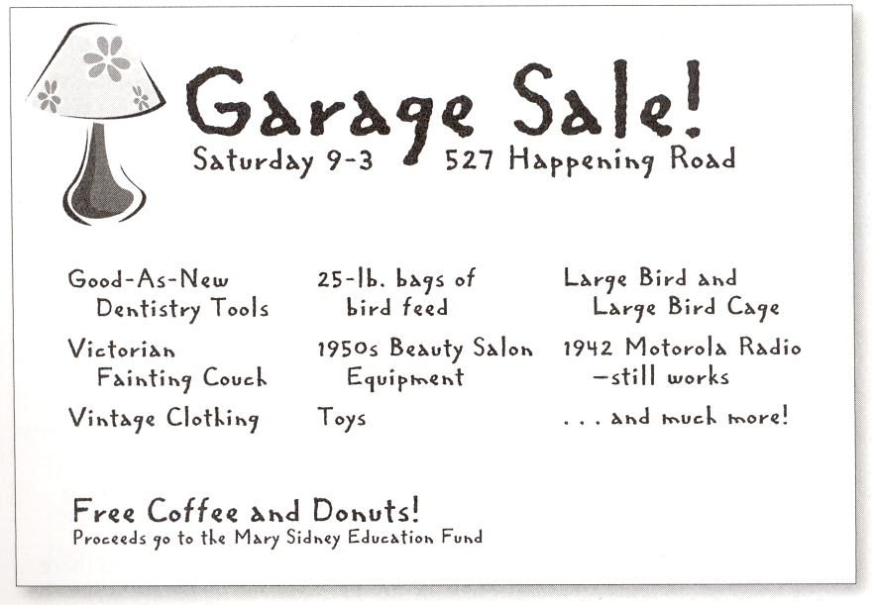
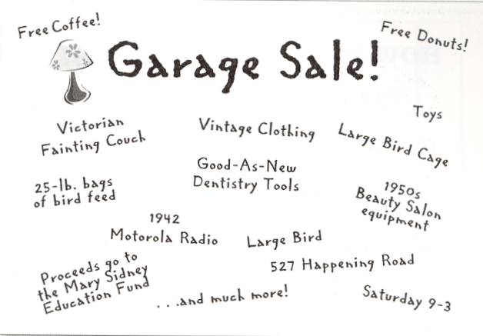

Slide 33
Alignment Thoughts
Every item on the page should have a visual connection with some other item.
Find a strong line and use it.
Basic purpose is to unify and organize.
Be conscious of where you place things.
Avoid using more than one alignment.
Be careful with centering.
Watch your white space

Slide 34
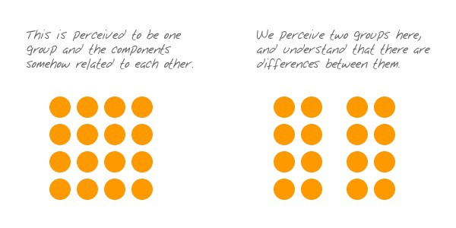
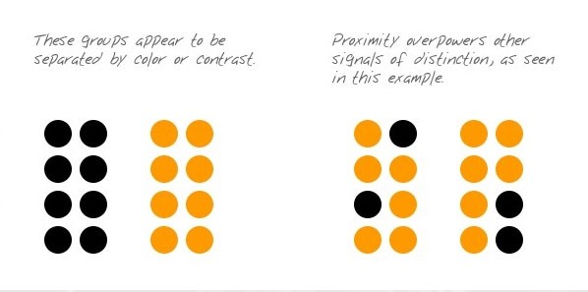
Proximity
https://uxplanet.org/gestalt-theory-for-ux-design-principle-of-proximity-e56b136d52d1

Slide 35
Proximity
Group related items together
Do not group unrelated items
The grouping gives the reader an instant clue to the organization pattern
When items are spread out users:
don't know where to start reading
can't distinguish flow
eyes tend to wander, can’t be sure if everything has been read
are not sure when you are finished

Slide 36
Closeness Implies Relationship
By grouping items the appear more organized
Users know where to start and stop reading
White space can be more effective
Establish relationships through closeness,
or a lack of closeness

Slide 37
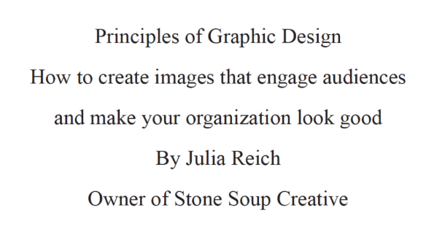
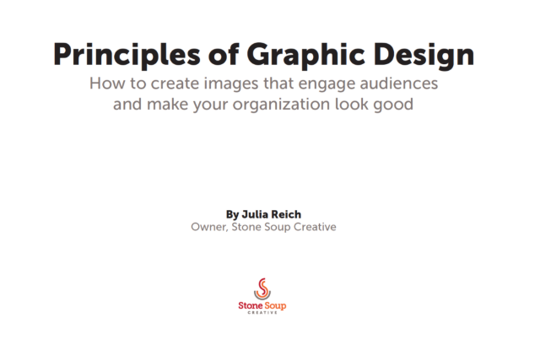

Slide 38
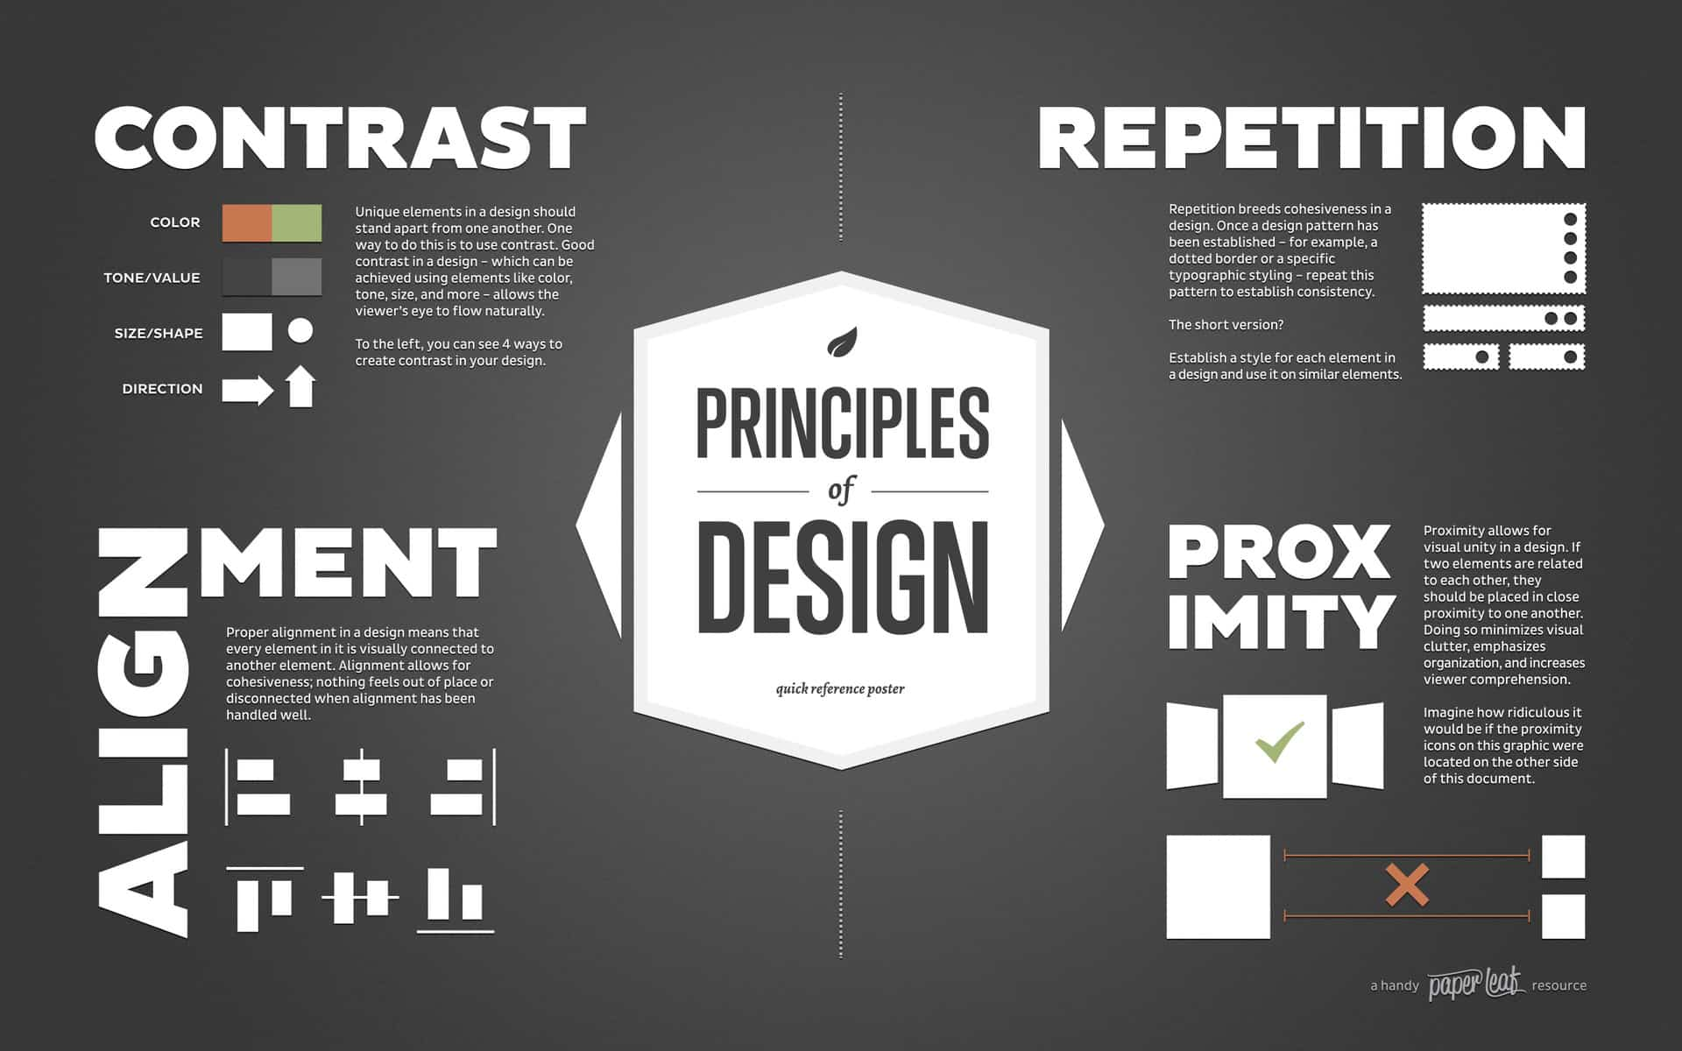
https://www.flottmanco.com/4-basic-design-principles-every-business-owner-should-know/

